Slide 1
ME 552 Thermal and Fluid Sciences Laboratory
Lecture 2
Notes:
ME 451

Slide 2
Introduction to Error and Uncertainty Analysis
…….. again a discussion of “so what”
Notes:
ME 552

Slide 3
Why is Uncertainty Analysis Important?
Determine what instrumentation (and cost) is required for the application (e.g., laser diagnostics vs thermocouples)
Determine how much confidence to put in the measurements (e.g., calculations compared to measurements, global warming)
Prepare for experiments or industrial processes (i.e., save cost and time)
Determine if products meet needed specifications (e.g., aircraft engines meeting required emission standards)
Critical for research (e.g., discussion of ignition delay for combustion research)
Bottom line - we can make better engineering decisions
Need to embrace it and be competent

Slide 4
Error
Any measurement, however carefully performed, has associated errors
Error –represents the difference between the true value and the measured value of a measured variable
Measured value: value returned by the measurement system
What is the “True” value?

Slide 5
What is the “True Value” of a dependent variable?
The intended measurement: temperature of gas at given location.
Define the “True temperature “ for this case
Hot gas from combustion chamber
T
Cold duct walls
thermocouple
Ref: R. J. Moffat, Describing Uncertainties in Experimental Results, Exp. Thermal Fluid Science,
1, pp. 3-17 (1988).

Slide 6

Repetition vs. Replication
Repetition: duplication of measurements under fixed operating conditions (i.e., during a single test run)
  Captures variation in a measured variable under no changes to independent variables
  Does not provide an estimate of how exact the independent variable can be set
Replication: duplication of measurements under nominally similar operating conditions
  Captures variations in the measured variable due to changes in independent variables
  It also captures the changes due to noise variables (a test for good operating procedures), if performed on different days
Notes:
ME 552

Slide 7
Uncertainty Basics
Since there is no clear way to identify a “true value” for a measurand, we cannot determine the error in a measurement and hence resort to defining uncertainty
Uncertainty refers to the best estimate of the difference between the true value and representative mean value
In a measurement, we aim to provide
  a single value that best represents the mean of the data
  a single value that best represents the variation in measured data from this mean value
  an interval about the mean value within which the “true” value might exist
Notes:
ME 552

Slide 8
Applications of Uncertainty Analysis
Design stage
Debug stage
Analysis stage
Data reporting and interpretation
Notes:
ME 552

Slide 9
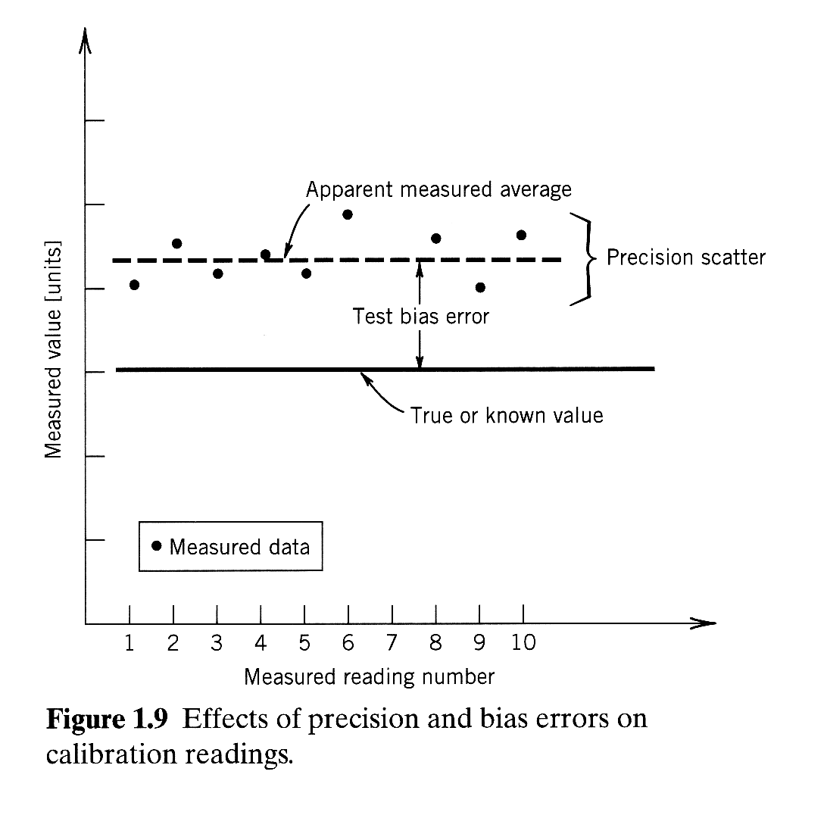
Accuracy, Bias and Precision errors
scanned from Figliola and Beasley (2000)
Accuracy: ability to indicate the true value exactly (accuracy “error” indicates the deviation)
Bias error: difference between true value and average/mean value
Precision error: deviation between repeated measurements
Notes:
ME 552

Slide 10
Sources of Measurement Uncertainties
3 elemental groups
  Calibration
  Data acquisition
  Data reduction
Notes:
ME 552

Slide 11
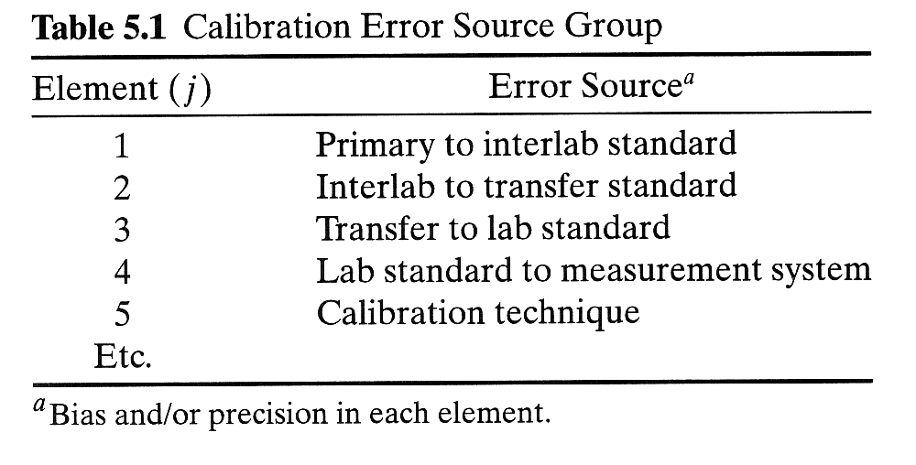
Calibration
Note that calibration is also an experiment, and has associated uncertainty
Calibration standards also have associated uncertainties
Figliola and Beasley (2000)
Notes:
ME 552

Slide 12
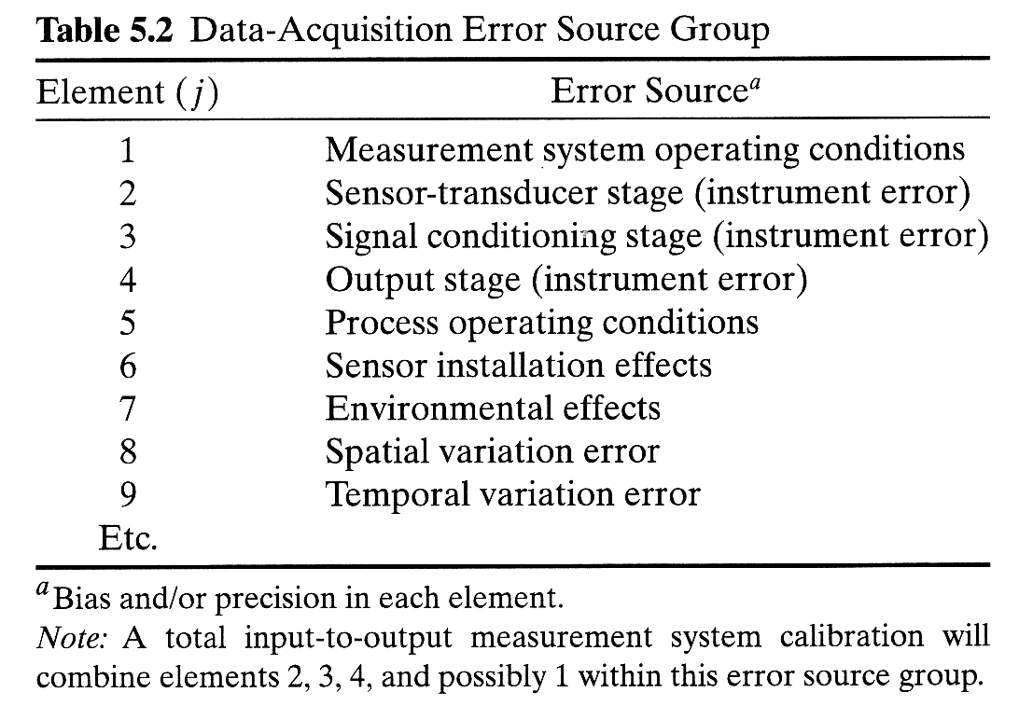
Data Acquisition
Figliola and Beasley (2000)
Notes:
ME 552

Slide 13
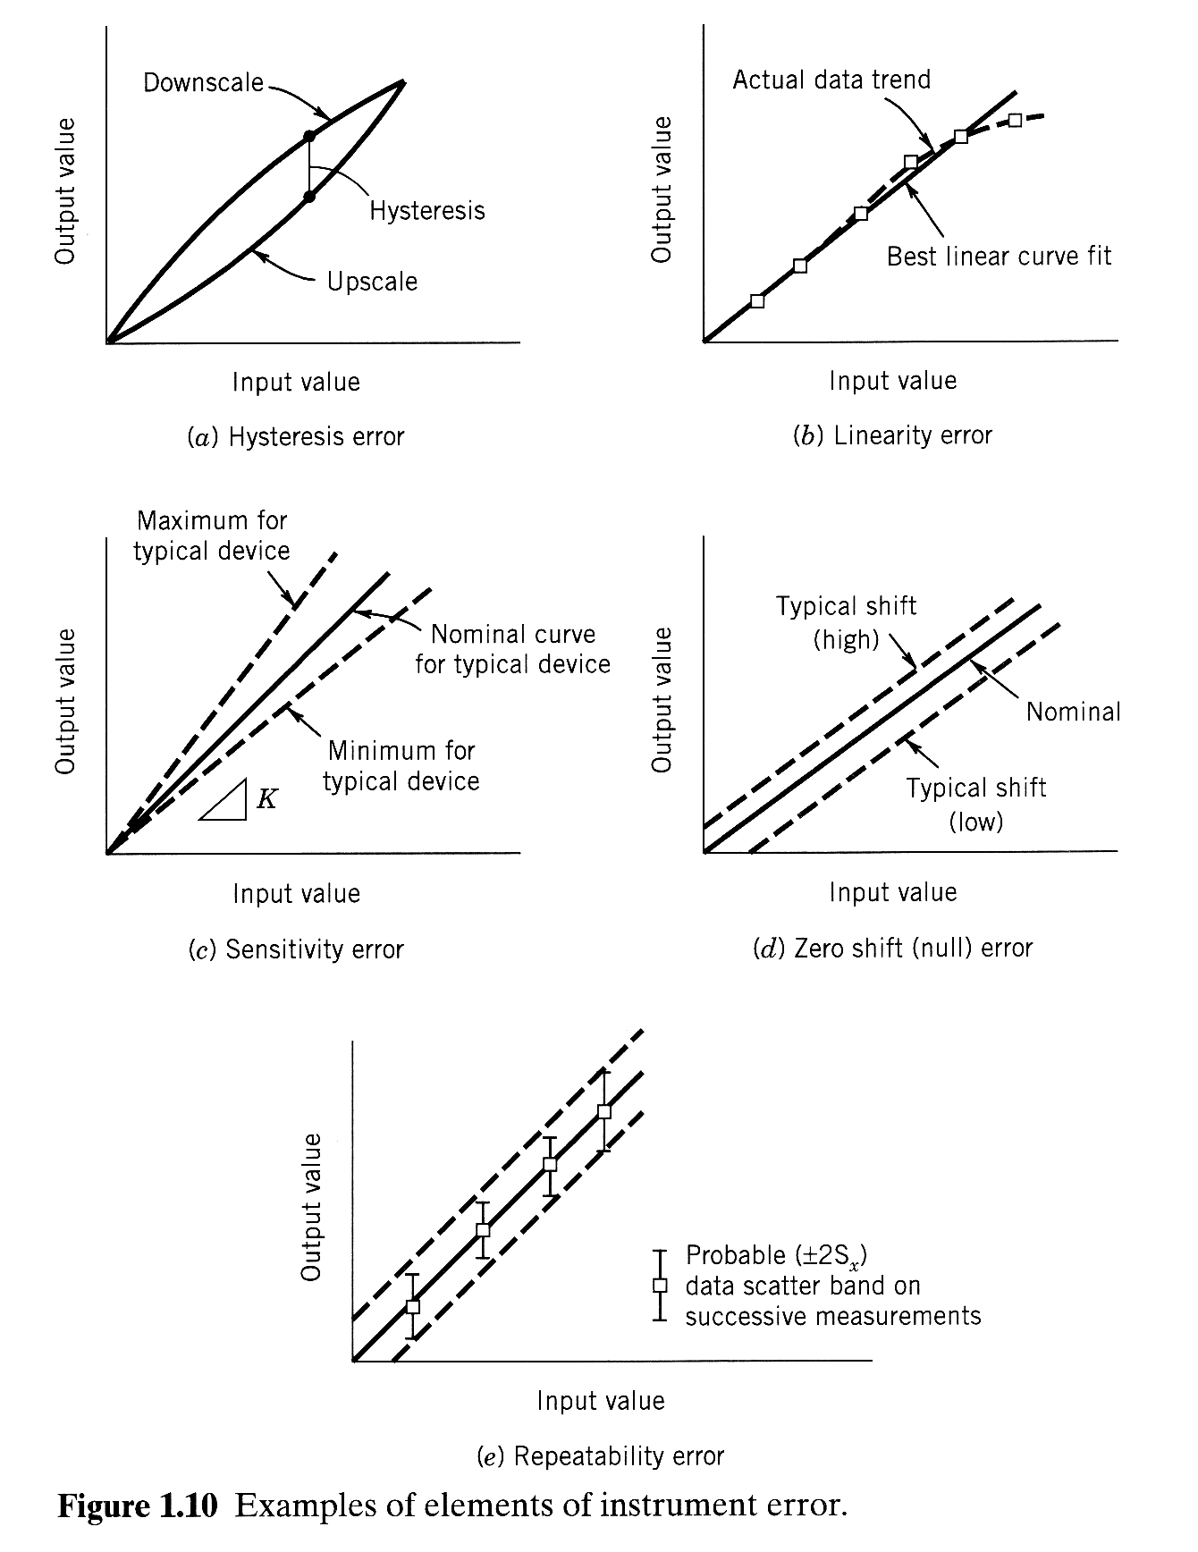
Types of Measurement System Errors
Hysterisis: difference between measured values going up and down in an independent variable
(account for it by running a random test matrix)
Linearity: deviaiton of calibration from a linear trend (perform calibration over desired range, account for non-linearity)
Sensitivity: deviation from calibration slope (for example, thermal drift)
Zero: cal. slope is correct, but there is a shift in zero (temporal, thermal or pressure shifts- turn electronics, perform pressure cycling, etc)
Repeatability: ability to indicate same value- precision error under controlled calibration conditions
Reproducibility: differences between multiple repeatability tests in different lab, for example
scanned from Figliola and Beasley (2000)
Notes:
ME 552

Slide 14
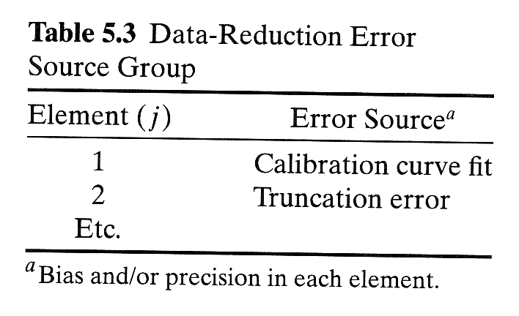
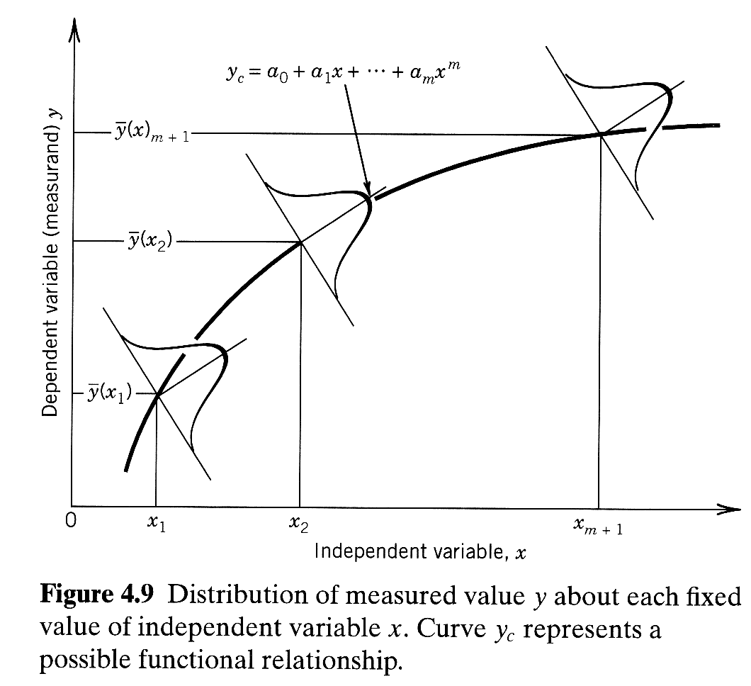
Data Reduction
Calibration curve fit- use a regression analysis to estimate the error in y(x)
Figliola and Beasley (2000)
Figliola and Beasley (2000)
Notes:
ME 552

Slide 15

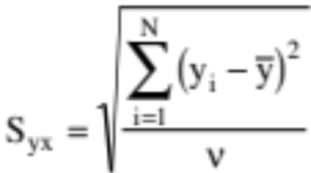


Curve Fit Error
A regression analysis is typically performed to fit a curve to data. A typical polynomial relating the dependent variable, y, to the independent variable, x, takes the form
where m is the order of the polynomial
The curve fit error can be obtained by
where is the degrees of freedom and N is the number of measurements

Slide 16
Review - Objectives for Lecture
Obtain an overview of course and appreciation for the importance of the course
Gain an understanding of measurement systems
Gain an appreciation for uncertainty analysis and have an introduction to the process

